Slide 1
GenAI + Low-Code Automation Framework for General Mills

Slide 2
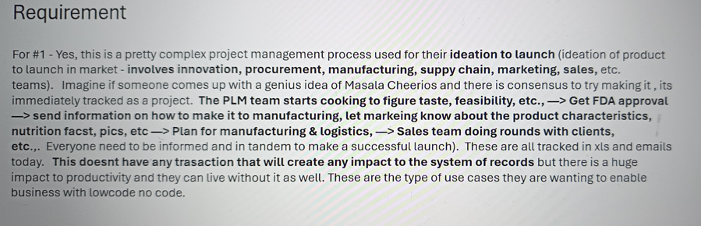

Slide 3
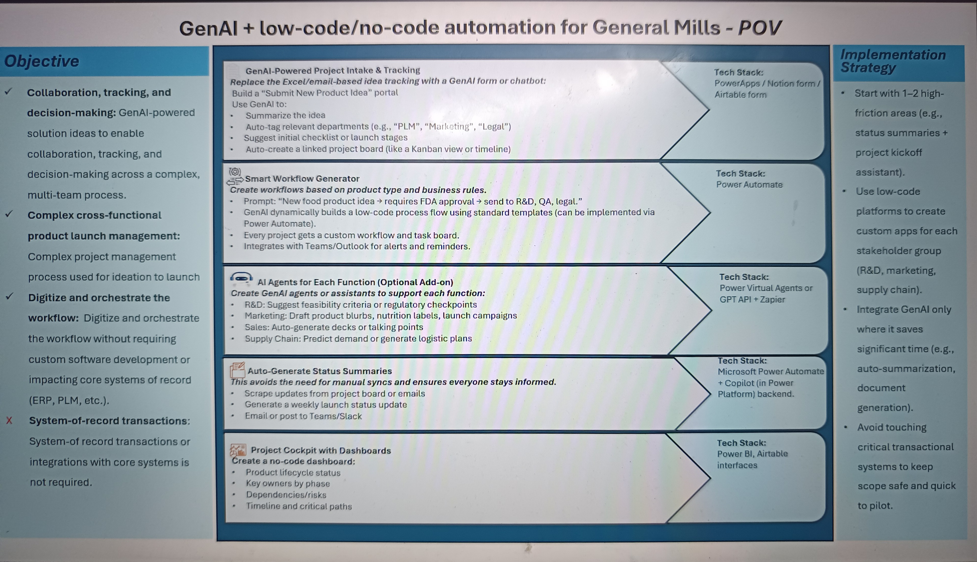

Slide 4
[Product Idea Initiation] │ ▼ [Create Project in Low-Code App] │ ▼ [PLM Team Analysis] - Feasibility study - Taste testing - Nutritional info preparation │ ▼ [Get FDA Approval] │ ▼ [Send Manufacturing Guidelines] - Recipes - Production steps │ ▼ [Marketing Team Input] - Product name - Nutrition facts - Product images - Launch messaging │ ▼ [Plan Manufacturing & Logistics] - Scheduling - Material procurement - Supplier coordination │ ▼ [Sales Team Engagement] - Client demos - Pre-orders - Feedback loop │ ▼ [Cross-team Tracking & Updates] - Status updates - Notifications - Approval checklists │ ▼ [Launch Readiness Review] │ ▼ [Product Launch] | [Power Apps Intake Form] │ ▼ [Azure OpenAI — Form Structuring] │ ▼ [Power Automate — Smart Workflow Routing] │ ├─→ Legal Approval │ ├─→ FDA & Nutrition Docs │ ├─→ Manufacturing Info │ └─→ Marketing & Sales Prep ▼ [AI Email Summary + Teams Bot (Q&A)] ▼ [Airtable or Dataverse — Workflow DB] ▼ [Power BI Dashboard + Weekly AI Digests]

Slide 5
✅ Option 1: One Modular AI Agent (Recommended for MVP) Uses role-based logic to route questions and summaries. Triggers different skills or prompts depending on the department (e.g., Legal vs. PLM vs. Marketing). Ideal for a Power Automate + Azure OpenAI + Prompt Flow setup. 📌 Pros: Easier to build and maintain, shared context, one chat endpoint 📌 Cons: Needs careful prompt engineering to avoid mixing context
Start with one AI agent with function-based prompts, and evolve into multiple micro-agents as needed. You can build this using:
Azure OpenAI + Power Automate
Prompt routing using role → skill map
Knowledge bases loaded dynamically from SharePoint/Airtable/Dataverse
If team = "PLM":
→ Load ingredients knowledge base
→ Use prompt: "Evaluate product feasibility..."
If team = "Legal":
→ Load allergen and labeling database
→ Use prompt: "Review label compliance for..."
If team = "Marketing":
→ Load product messaging templates
→ Use prompt: "Suggest a launch tagline for..."
If team = "Sales":
→ Load client database and pre-order history
→ Use prompt: "Summarize key clients for pre-launch offer..."

Slide 6
✅ Option 2: Multiple Specialized AI Agents (Good for Scale or Enterprise) Design 4 separate AI agents — each trained/focused on a domain: PLM Agent: Knows ingredient DBs, feasibility reports, past launches. Legal Agent: Focused on compliance, allergen rules, approval workflows. Marketing Agent: Suggests messaging, images, target groups. Sales Agent: Handles pre-orders, pricing questions, pitch decks. Each agent can be exposed as a chatbot, API, or Teams app, and optionally integrated into Power Automate steps. 📌 Pros: Better accuracy, easier to fine-tune per department 📌 Cons: More complex architecture, requires coordination
Start with one AI agent with function-based prompts, and evolve into multiple micro-agents as needed. You can build this using:
Azure OpenAI + Power Automate
Prompt routing using role → skill map
Knowledge bases loaded dynamically from SharePoint/Airtable/Dataverse
If team = "PLM":
→ Load ingredients knowledge base
→ Use prompt: "Evaluate product feasibility..."
If team = "Legal":
→ Load allergen and labeling database
→ Use prompt: "Review label compliance for..."
If team = "Marketing":
→ Load product messaging templates
→ Use prompt: "Suggest a launch tagline for..."
If team = "Sales":
→ Load client database and pre-order history
→ Use prompt: "Summarize key clients for pre-launch offer..."

Slide 7
Area | Suggestion | Why
Governance & Compliance | Add a “Compliance Checklist Generator” step using GPT | Covers regulatory needs like FDA, GDPR, nutrition facts
Audit Trail | Log all AI-generated summaries and actions | For traceability and decision justification
Integration Readiness | Indicate that Airtable could be replaced by Dataverse or SharePoint | In case enterprise policy doesn’t allow Airtable
Security | Mention usage of Azure Managed Identity & Key Vault | Addresses data security and app authentication concerns
Fallback Handling | Have manual override options for AI-generated flows | Keeps human-in-the-loop where needed (e.g., Legal or FDA)
🔧 Suggested Enhancements

Slide 8
Team | Meaning | Human or AI? | What happens?
Legal Approval | Internal legal experts | ✅ Human | Review AI-generated summary and provide go/no-go
FDA & Nutrition Docs | Regulatory team or PLM SME | ✅ Human | May use AI-generated templates, but verify
Manufacturing Info | Ops/Production | ✅ Human | Receives structured brief, prepares SOPs
Marketing & Sales Prep | Marketing team | ✅ Human | Uses AI drafts but fine-tunes name, messaging, images
👥 Who are these “teams”?
👉 These are actual humans, not AI agents. AI is used before their step to auto-draft and route, but human teams verify, finalize, and take action.
👉 These are actual humans, not AI agents. AI is used before their step to auto-draft and route, but human teams verify, finalize, and take action.

Slide 9
🔄 How the JSON Flow Might Look (Simplified)
json
CopyEdit
{
"productName": "Healthy Oat Cereal",
"category": "Food",
"audience": "Kids under 12",
"region": "North America",
"workflow": {
"Legal": {
"status": "Pending",
"owner": "legal@company.com",
"summary": "Allergen labeling check required"
},
"FDA": {
"status": "Initiated",
"notes": "Nutrition labels need validation"
},
"Manufacturing": {
"status": "Not started"
},
"Marketing": {
"status": "In Progress",
"assets": ["draft_name", "image_placeholder.jpg"]
}
},
"ai_summary": "Cereal launch for kids under 12 in NA. Needs legal, FDA, mfg, marketing."
}
Who Does What?
Stage | AI Role | Human Role
Form Processing | Converts text into structured fields | None
Routing | Sends tasks to right teams based on logic | None
Email Summaries | Auto-generates summaries | Humans read & act
Bot Q&A | Retrieves insights on request | Humans ask questions
Review/Approval | ❌ No AI decision | ✅ Humans approve
Data Storage | JSON stored in Airtable/Dataverse | Used by humans and AI for tracking

Slide 10
🧩 SCENARIO: "Healthy Oat Cereal for Kids" — AI-Powered Product Launch Workflow
Let’s go deep into the PLM team’s journey — with traditional vs AI-enhanced steps:
Traditional PLM Process (Manual)
Step | Task | Tool | Challenge
1 | Intake product idea (Excel/email/meeting) | Email, Excel | No standard format, info missing
2 | Feasibility analysis | Excel, Word | Manually check similar launches
3 | Coordinate taste testing | Email/calendar | Delays due to poor communication
4 | Prepare nutritional content | Manual doc creation | Time-consuming, manual data gathering
5 | Share with legal/FDA | Email attachments | Version confusion, delay in review
AI-Powered PLM Process (New Flow)
Step | Task | AI Help? | Tool | What Happens
1 | Receive product idea | ✅ | Power Apps + Azure OpenAI | Natural language input auto-structured
2 | Auto-assigned task to PLM | ✅ | Power Automate | Based on category = "Food"
3 | AI-generated summary brief | ✅ | OpenAI + Email | AI prepares 3-5 bullet points from user intent
4 | AI suggests similar past launches | ✅ | Teams Bot + GPT | "Show me oat cereal for kids since 2022"
5 | PLM reviews feasibility, taste testing plan | ❌ (Human) | Airtable task page | Refers to AI summary + previous launches
6 | Nutrition info: AI drafts content from templates | ✅ | GPT + Prompt Templates | E.g., "Per serving: 5g sugar, 3g fiber..."
7 | PLM sends doc to Legal | ✅ + ❌ | Email with summary link | Summary auto-sent; doc review is human

Slide 11
What PLM gets, does, and benefits?
What PLM team receives:
• An AI-generated summary email:
"New Product: Healthy oat cereal for kids.
Region: US | Age Group: 6–12 | Category: Food
Key next steps: Feasibility analysis, nutritional prep, taste testing setup."
• A Teams bot command ready like:
Show similar launches in 2022 for oat cereal in kids category.
→ AI returns 3 matching products with summary metrics.
• A task entry in Airtable/Dataverse:
{
"team": "PLM",
"task": "Perform feasibility analysis",
"status": "Assigned",
"dueDate": "2025-06-05",
"linkedSummary": "https://summarylink.com/oat-cereal-brief"
}

Slide 12
LEGAL TEAM VIEW 🧾 Before (Manual): Got random email from marketing with incomplete info Had to search folder for similar labels Reviewed PDF manually, emailed edits
After (AI-Powered):
Step | Task | AI Help? | Tool
1 | Receive auto-summary email | ✅ | Email from Power Automate
2 | Ask bot for allergen info in similar products | ✅ | GPT in Teams
3 | Open link to structured document | ❌ (human) | SharePoint / Airtable
4 | Add comments in approval checklist | ❌ | Power App/Task form
5 | Click Go/No-Go | ❌ | UI button in task tracker

Slide 13
🔁 Is AI Chatbot Response Sent Over Email?
✅ Yes, summary emails include AI-written content, such as:
"Allergen warning: Contains oats, may contain traces of peanuts. Based on similar cereal from 2023, no FDA issues reported."
✅ You can enable a feature where the Teams Bot answers (e.g., similar product info, past recalls) are:
Logged in Airtable under “referenceInsights”
Or auto-forwarded to email/Teams chat thread as follow-up.

Slide 14
How AI Helps Overall
Function | How AI Adds Value
Intake | Structures unstructured ideas
Routing | Ensures all relevant teams notified
PLM | Shows past feasibility wins/fails
Legal | Surfaces known allergen warnings
Nutrition | Drafts label content from standard templates
Manufacturing | Suggests known processes based on product type
Sales/Marketing | Auto-drafts product name, key claims, images
Email Summary | Reduces manual comms
Weekly Digest | Replaces manual status meetings
Teams Bot | AI acts as a "knowledge concierge"

Slide 15
How AI Supports Feasibility & Taste Testing (PLM Team):
Step | Manual Work (Before AI) | AI-Enabled Approach
1. Feasibility Review | PLM team manually checks internal docs, product constraints, market research, regulatory risks. | 🔹 AI Agent scans historical product launches, checks constraints (e.g., allergens, region-based laws), and flags potential blockers. 🔹 Uses NLP to pull key insights from PDFs, emails, old product specs.
2. Taste Testing Setup | Coordinators manually create schedules, track tasting sessions, record feedback. | 🔹 AI agent drafts test schedules, auto-sends invites, and uses structured forms to collect feedback. 🔹 Summarizes tester comments using GPT.
3. Nutritional Info Prep | Nutritionist calculates calories, allergens, and label compliance manually. | 🔹 AI compares ingredients with nutritional DBs (like USDA) to auto-suggest macros and allergen tags. 🔹 Generates draft nutrition labels for review.
4. Internal Approvals | Cross-team email chains & scattered docs. | 🔹 AI-generated summaries shared via Teams + email with checklist and versioning. 🔹 Decision logs stored in Airtable or Dataverse.
Where AI Agent Helps the PLM Team:
Data Mining: Find similar products in your DB and their issues.
Label Drafting: Suggest FDA-style nutritional labels.
Automated Risk Alerts: Example: “Ingredient A is restricted in EU.”
Document Summarization: Hundreds of pages summarized for legal/regulatory checks.
Chatbot Q&A: “What did we launch in 2022 for age 5–12 with honey flavor?”

Slide 16
Example Scenario (PLM Use Case):
"We want to launch a cinnamon oat cereal for ages 6–12."
AI finds 3 similar past products, extracts their success/failure insights.
Suggests initial feasibility checklist (e.g., legal allergen constraints).
Creates a nutritional label template based on oat, cinnamon, sugar content.
Sends summary to R&D, Legal, Marketing for early go/no-go.

